Slide 1
ESL writing model tested : an action research
I. H. S. Fernando¹ and M. Perera²
¹CINEC Campus , Malabe
² Department of Humanities Education , University of Colombo

Slide 2
Background
Writing is the most difficult skill for language learners to master. (Richards & Renandya ,2002)
As per the G.C.E.(O/L) Examination 2016: Evaluation Report- English Language, the skill-wise analysis of the achievement levels, achievement of writing skill remains as low as 19%.
As recorded in the National Report– National Assessment of Achievement of Students Completing Grade 8 in Year 2016 in Sri Lanka , achievement of English Language is recorded the lowest and writing skill indicates the lowest achievement contributing to the overall low performance in English.
The ability to write effectively is becoming more and more important and both writing instruction and training the learner in the use of writing strategies are assuming increasing roles in L2 language education. (Weigle ,2002)
Teachers should be dedicated to fostering growth in writing by providing a sequence of lessons to move students beyond their entering skill level , and enabling students to acquire skills and strategies needed to perform well in written communication. ( Kroll ,1990)

Slide 3
Research objectives
The overall purpose of the study is to improve writing skills of the ESL learner through the adoption of the writing model formulated and the research objectives are as follows:
1. Formulate a tentative writing model to improve writing skills in ESL learners
2. Carry out an intervention adopting the writing model to improve writing skills in ESL learners
3. Measure the effectiveness of the writing model
4. Develop a model to improve writing skills in ESL learners

Slide 4
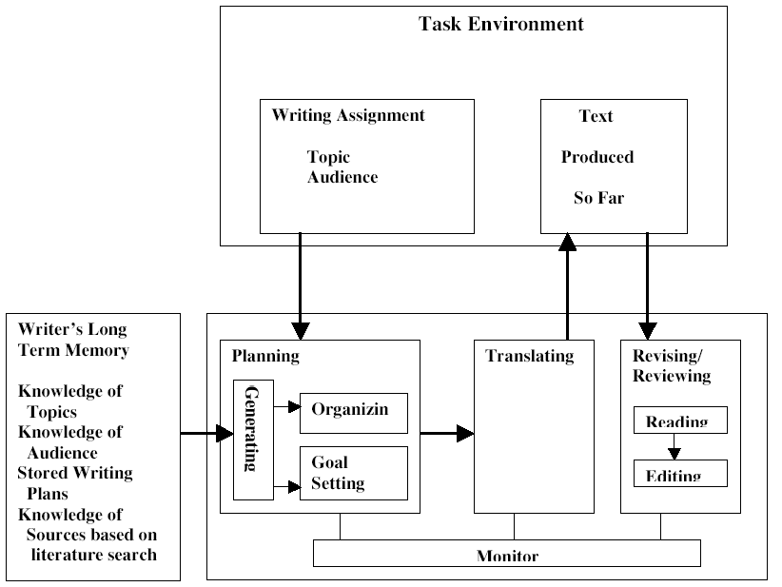

Slide 5
Methodology
ACTION RESEARCH
Formulation of the Tentative Model of Writing
Pre-Test
Activities Intervention Assignments Workshops
Reflective Journals Field Notes
Post-Test
Measurement of the Effectiveness of the Intervention
Comparison of Pretest –Posttest Marks
Comparison of Assignment Marks

Slide 6
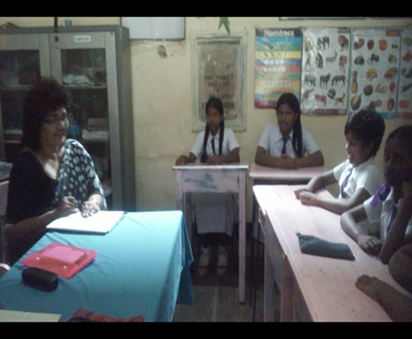
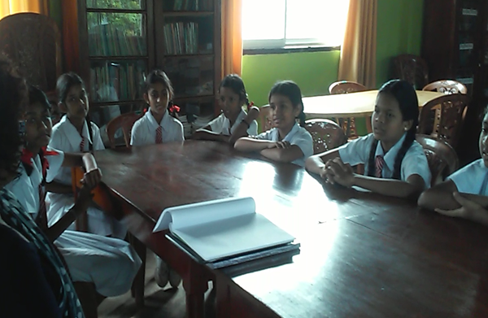
22 students - Type 1C School – Colombo South Zone
20 Sessions of 80 minute duration - six months – From January 2018 – July 2018

Slide 7
Intervention
Stage 1 Imperatives | Recipes Dos and Don’ts - Nature Good Habits
WORK_SHOP ONE _ MECHANICS | OF WRITING
Stage 2 Picture Description | Classroom Bedroom Park Fair
WORKSHOP TWO _ PAIRWORK | AND GROUPWORK
Stage 3 Describe a Person | My Grade One Class Teacher My Mother My Favourite Person
Stage 4 Describe a Place | My School Home Sweet Home My Country My Hometown
Stage 5 Write a Note | Note to mom Reply Note to a Friend
Stage 6 Write a Notice | Cultural Day Tree Planting Day Nature Club Readers’ Club
Language Games
Motivation / Prior knowledge
Guided Writing Activities-
Translation
Fill in the blanks.
Match.
Listen and complete.
Rearrange.
Sentence writing.
Equip the learner with structures , ideas and vocabulary
Model Writing
Resourcing
Free Writing
Brainstorming
Revising / Feedback - Portfolio
Assignment
Testing the model

Slide 8
Comparison of Assignment Marks
Marks | 0-10 | 11-20 | 21-30 | 31-40 | 41-50 | 51-60 | 61-70 | 71-80 | 81-90 | 91-100
Ass: 1 |  | 01 | 14 | 04 | 03
Ass: 2 |  | 01 | 10 | 09 | 02
Ass: 3 |  | - | 05 | 08 | 05 | 03 | 01
Ass: 4 |  | - | 05 | 04 | 09 | 03 | 01
Ass: 5 |  | - | 02 | 02 | 14 | 02 | 02
Ass: 6 |  | - | - | 02 | 08 | 06 | 05 | 01

Slide 9
Comparison of Pre-Test and Post-Test marks

Slide 10
Analysis of Reflective Journals and Field Notes Positives
SS like language games a lot.
Guided writing activities are a must for them to get started.
Group / Pair work motivate SS to actively take part in writing.
Feedback is essential to keep SS in task.
Clear instructions sometimes using mother tongue facilitate classroom activity.
Simple to complex method in carrying out writing activities is effective.
Portfolio as a strategy in writing class was very effective.
Rapport is the key.

Slide 11
Negatives
Mechanics of writing - SS were inconsistent , thus needed remedial measures.
Group/ Pair work - SS needed practical sessions to improve on it.
Resourcing - SS were ignorant about it. Habit formation was very difficult. But initiatives were taken.

Slide 12
Findings
The major difficulties students face in writing , their lack of knowledge of grammar , vocabulary , word order etc. needed for translation could be facilitated through guided writing activities such as model writing , translation, rearranging which are carried out prior to the writing activity.
Students lack of ideas which is a difficulty faced by the writing learner could be facilitated through the use of picture clues and word clues , brainstorming activities etc..
Training the writing learner in the use of strategies such as pair work / group work , getting feedback , resourcing , revising , portfolio writing leads to the gradual improvement of their writing skills and also it gives the learner a sense of satisfaction and motivation.

Slide 13
Conclusions
Both linguistic knowledge and linguistic skills should be treated with equal importance in the ESL writing class. Thus, a blended approach to writing is more effective in ESL context.
Writing activity should not be regarded as one single activity to be completed in one single period , but as a sequence of activities to be completed over a period of time.
Writing learners should be trained in the use of strategies to overcome problems they face in the execution of writing in ESL.

Slide 14
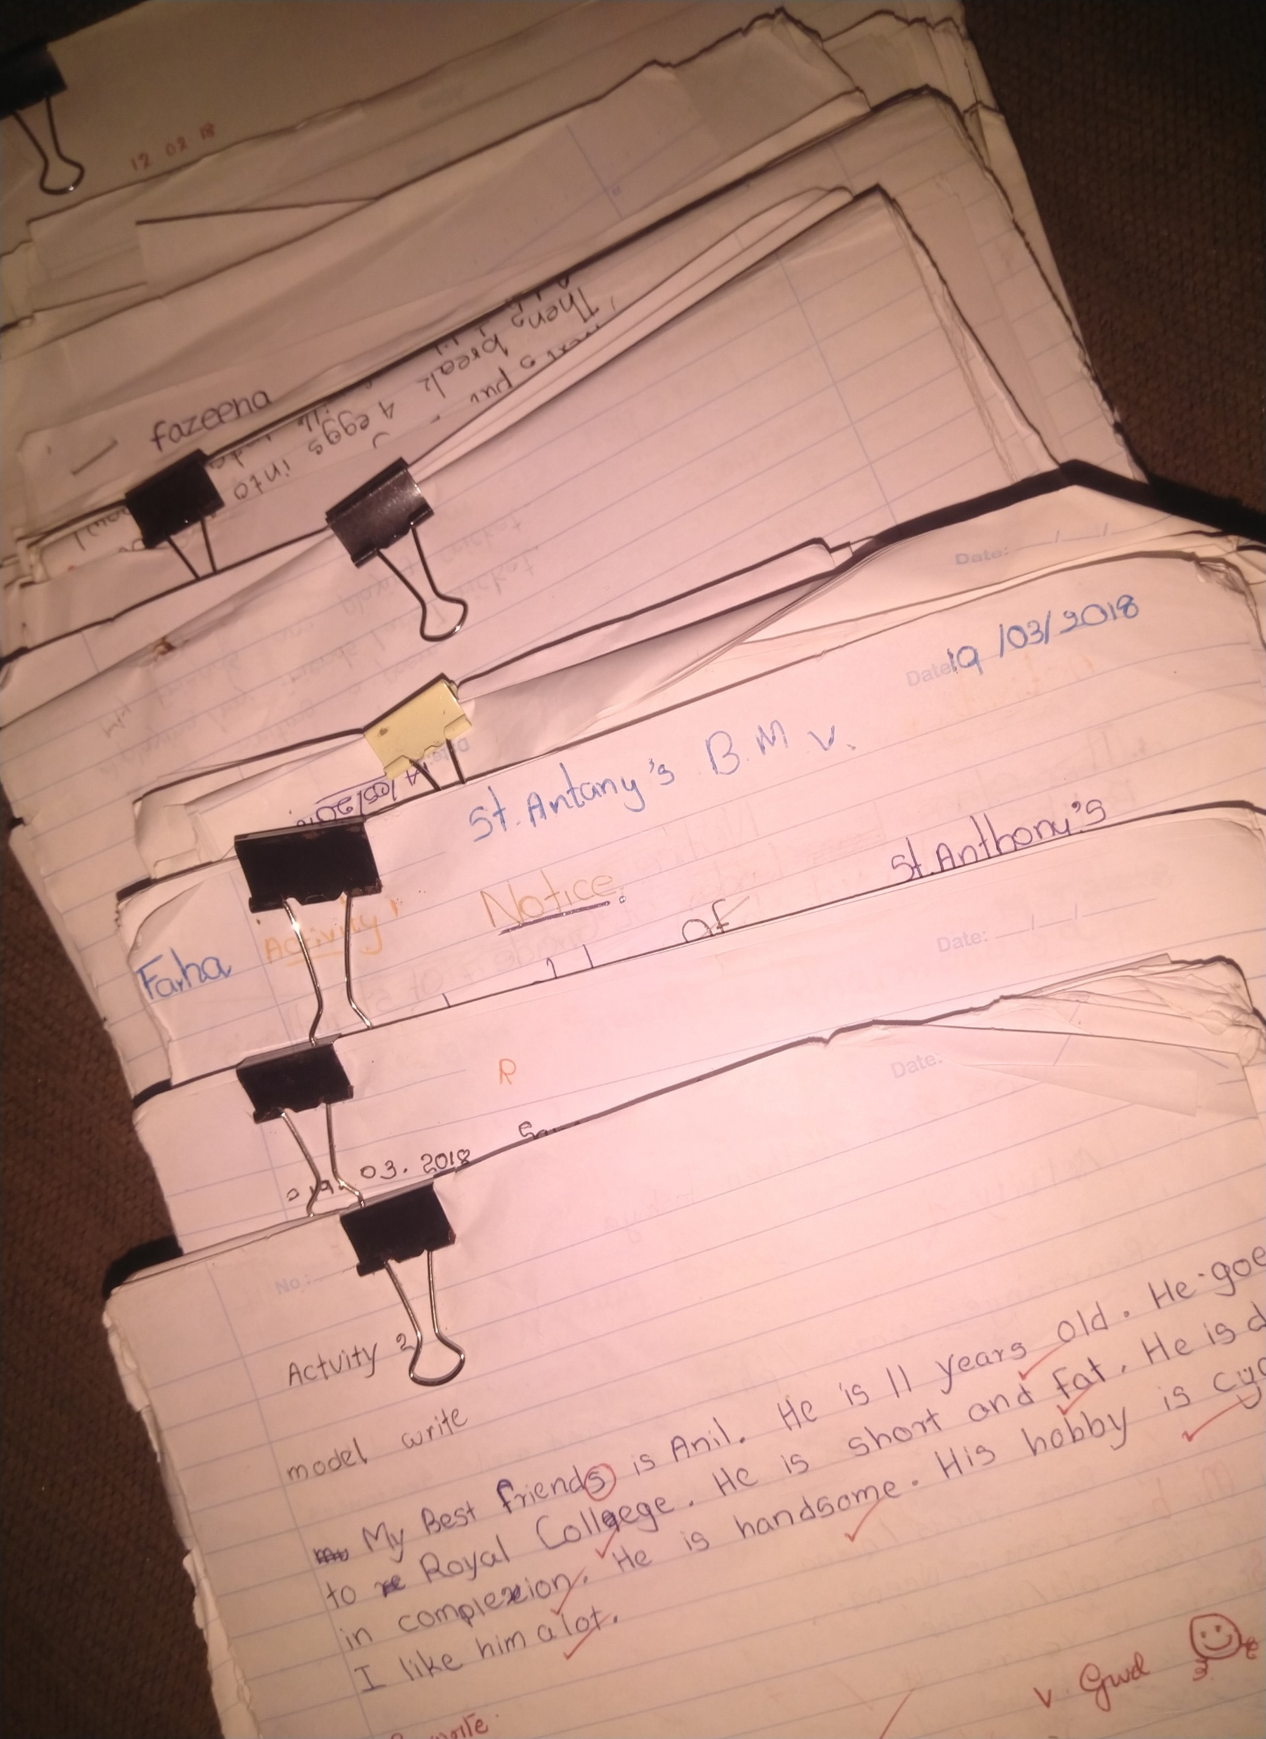

Slide 15
References
Kroll, B. (1990). Second language writing: research insights for the classroom. Cambridge: Cambridge University Press.
National Education Research and Evaluation Centre (NEREC) 2015. National Assessment of Achievement of students completing grade 4 in 2014 Colombo: Sri Lanka
National Policy Framework on Higher Education and Technical and Vocational Education (2009), Retrieved from : http://nec.gov.lk/post6/
Richards, Jack C./Renandya, Willy Ardian (eds.) (2002): Methodology in Language Teaching: An Anthology of Current Practice. Cambridge: Cambridge University Press.
Weigle, S. C. (2002). Assessing Writing. Cambridge: Cambridge University Press.
Bibliography
Astuti (2015). Teachers and Students Perceptions of Motivational Teaching Strategies in Indonesian High School Context : Retrieved from : http://hdl.handle.net/10063/3760
Bereiter, C. & Scardamalia, M. (1987). The psychology of written composition. Hillsdale, NJ: Lawrence Erlbaum Associates.
Ellis, R. (1994). The Study of Second Language Acquisition, Oxford, Oxford University Press.
Evaluation Report (2016). G.C.E. (O/L) Examination 2014 English Language. Department of Examinations: Sri Lanka.
Flower, L. & Hayes, J. (1981). A cognitive process theory of writing: College Composition and Communication, 32, 365-387.
Hedge, T. (1988). Writing. Oxford University Press.
Krashan, S. (1981) . The Input Hypothesis: Issues and Implications, London, Longman.
Kroll, B. (1990). Second language writing: research insights for the classroom. Cambridge: Cambridge University Press.
National Education Research and Evaluation Centre (NEREC) 2015. National Assessment of Achievement of students completing grade 4 in 2014 Colombo: Sri Lanka
National Policy Framework on Higher Education and Technical and Vocational Education (2009), Retrieved from : http://nec.gov.lk/post6/
Oxford, R L (1990). Language learning strategies: What every teacher should know. New York: Newbury House
Perera, M. (2015). English Language Textbooks for Primary Grades : A Saffold for Developing Writing Skills’, University of Colombo.
Raimes, A.(1983). Techniques in Teaching Writing: Oxford University Press.
Richards, Jack C./Renandya, Willy Ardian (eds.) (2002): Methodology in Language Teaching: An Anthology of Current Practice. Cambridge: Cambridge University Press.
Steele, V. (1992). Product and process writing: a comparison. Rowley: Newbury House.
Swain, M. (1995). Three functions of output in second language learning. In. G. Cook and G. Seidhofer (Eds.) Principles and practices in applied linguistics: Studies in honor of H. G. Widdowson (p. 125-144). Oxford: Oxford University Press.
UNESCO Report (2006) , Mid -decade Assessment Report -Sri Lanka : 2000-2006 : Ministry of Education : Sri Lanka.
Utami, F. , Rais. A., Setyaningsih, E. (2010). Improving Students’ Writing Skills Using a Four Phase Technique’ : Sebelas Maret University ‘ Surakarta.
Vygotsky, L. (1962). Thought and Language, Cambridge, MA: MIT Press 15
Wenden, A L (1991). Learner strategies for learner autonomy. UK: Prentice Hall
Wickramanayake, L. (2007). Impact of Second Language Concepts on the Improvement of Writing Skills : An Action Research : University of Colombo
Zamel, V. (1985.) Responding to student writing. TESOL Quarterly, 19, 79-102

