Slide 1
Attitudes and Practices of Undergraduates in Learning English as a Second Language in State Universities
in Sri Lanka.
Doctor of Philosophy
Faculty of Education, University of Colombo
Candidate’s Name: S. P. Vanderkoon
Registration No: 2016/PhD/FT/03
Supervisor’s Name : Dr. L . Wedikkarage

Slide 2
Background to the Study
Beginning of 1960s the Sri Lankan universities took some steps for teaching English as a second language (ESL).
At the outset English language was taught with a limited purpose.
Universities by setting up and developing ELTUs have taken much effort to teach English as a second language.

Slide 3
Problem Statement
English as a Second Language (ESL) is taught in Sri Lankan universities for undergraduates.
When the unemployment problem in Sri Lanka is analyzed, a higher percentage of newly passed out graduates have waited longer period than other job aspirants to find employments. (CBSL, 2015).
Major problem of this study is not obvious undergraduates’ attitudes and practices with regard to learning English as a second language in universities.

Slide 4
Research Objectives
Main objective:
To find out undergraduates’ attitudes and practices with regard to learning English, specially speaking skills by following ELTUs’ classes and other facilities provided by the state universities in Sri Lanka.
Sub objective:
To identify classroom practices with regard to teaching speaking skills.

Slide 5
Significance Of the Study
In helping designing the curriculums.
Motivating the students.
Contributing to the language and communication skills development of future workforce.
Contribute to framing best practices to design programmes.

Slide 6
Brief Literature Review
1. Researchers such as (AL Mamun, at. el., 2012), (Soleimani & Hanafi, 2013) undergraduate students have positive overall attitude regarding English language learning in developing countries such as Iran, Malaysia etc.
2. (Khoshsaligheh, Jamali, & Saeedian, 2014) although certain group of students hold positive attitudes to learn English, they hold negative attitudes of the current English language education curriculum offered in the universities, textbooks, and teaching methods.
3. (Rukh, 2014) states that business students have a positive attitude towards English language learning and its’ association with their academic achievement.
4. ( Ahmed,2015) most of the students have negative feelings or fear regarding classroom instructions and teaching methodologies.
5. (Al Samadani & Ibnian, 2015) studeents who are having more positive attitudes have higher grade points average (GPA).
6. (Pushpananda,2016) although undergraduates have positive attitudes towards learning English in general, they held negative attitudes towards learning English within the university.

Slide 7
Conceptual Framework
Source: Compiled by the Researcher based on the Literature Review .
ATTITUDES (behavioral, cognitive, emotional aspects)
PRACTICES (effective work, concrete visual aids)
ESL
speaking
FACTORS (lectures, parents, peers, international
experience )
DEMOGRAPHIC FACTORS ( gender, area, school)

Slide 8
Sample/ Participants Sample size is 280 undergraduates. Population considered is , the 1st year and the 2nd year undergraduates, in Science faculties. Undergraduates have been selected using convenience sample. ELTU personals have been selected using judgment sampling.
Name of the University | Faculty | Number of 2nd year Undergraduates Attitudes | Number of 1st year Undergraduates Practices | Number of Lecturers interviewed
1) Colombo | Science | 50 | 20 | 4
2)Jayawardenapura | Science | 50 | 20 | 4
3) Peradeniya | Science | 50 | 20 | 4
4) Kelaniya | Science | 50 | 20 | 4

Slide 9
Research Design /Methodology
Mixed method of inductive and deductive reasoning.
Multiple data collection instruments.
phase one - questionnaires were administered.
phase two - class room observations were conducted.
phase three - sixteen lecturers were interviewed.
questionnaire has been designed inserting both close ended and open ended questions. Nominal, Ordinal and interval data have been used. Licket scale type questions have been included with a view to quantify qualitative aspect.

Slide 10
Data Analysis
Reliability Analysis
I
Variables | Cronbach's Alpha | No. of Items
Cognitive | 0.741 | 6
Behavioral | 0.677 | 7
Emotional | 0.769 | 8
Class room practices | 0.750 | 21
Lectures, parents, peers | 0.744 | 16
ESL speaking | 0.715 | 6

Slide 11
Goodness of Fit
Variables | GFI | AGFI | NFI
Cognitive | 0.98 | 0.953 | 0.946
Behavioral | 0.898 | 0.796 | 0.666
Emotional | 0.912 | 0.842 | 0.798
Class room practices | 0.813 | 0.751 | 0.618
Lectures, parents, peers | 0.898 | 0.860 | 0.803
ESL speaking | 0.972 | 0.935 | 0.936

Slide 12
Factors effect on ESL speaking: Multiple Regression Model
Auto Correlation Test/ Independent of Residuals:
D-W test statistics is between 1.5 and 2.5. Residuals are independent

Slide 13
Variance Inflation Factor:
VIF is less than 10: No Multicollinearity problems.

Slide 14
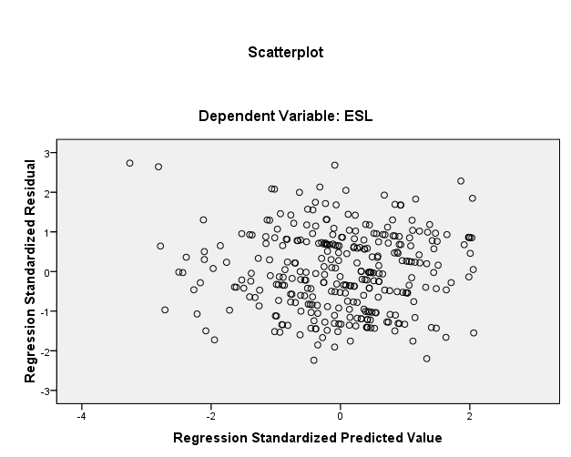
Heteroscedasticity Test

Slide 15
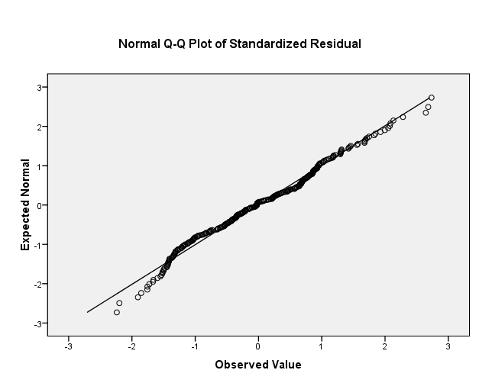
Normality Test

Slide 16
Conclusion
cognitive, behavioral, emotional aspects, class room practices and lectures:
higher responses
ESL: less responses
Factors: jointly effect on ESL.
Individually effect: class room practices is positive
lectures is negative
Year of study: first year is higher than the second year in ESL
English proficiency, ethnicity and language speak at home influence on ESL

Slide 17
Order of the major influencing factors

Slide 18
List of References
Al samadani, H. A., & Ibnian, S.S.(2015). The Relationship between Saudi EFL Students’ Attitudes towards Learning English and their Academic Achievement. International Journal of Education and Social Science , 92.
Al-Tamimi, A., & Shuib, M. (2009). Motivation And Attitudes Towards Learning English: A Study Of Petroleum Engineering Undergraduates At Hadhramout University Of Sciences And Technology. GEMA Online Journal of Language Studies , 29.
Alzwari, H., & Jafre Zainol Abidin, M. (2012). FL Students’ Attitudes towards Learning English Language: The Case of Libyan Secondary School Students. Asian Social Science , 119.
Bristi, N. L. (2015). Bangladeshi Engineering EFL Learners’ Attitudes towards Learning English: A Comparison between Public University and Private University Students. Global Journal of HUMAN-SOCIAL SCIENCE: G Linguistics & Education , 7. Central Bank of Sri Lanka, Annual Report / CBSL (2015). Colombo.
Perera, M. (2010). Coping with student heterogenity in the English language class rooms-a collaborative action research. National Education Commission.
Rama, M. (1994). ‘Flexibility in Sri Lanka’s Labour Market’, Policy Research Working Paper – 1262, World Bank.
Suwandaratna, D (2003). ‘A survey of the Causes Responsible for Absenteeism of Undergraduates in English Language Classes and Proposals for Remedial Measures’, Unpublished M. Phil Research, Kelaniya University.

Slide 19
Thank You.

